Slide 1
AESIS International Winter Course
Oslo, 27.11.2019
Scientific quality and societal impact
Liv Langfeldt

Slide 2
My talk
A framework for understanding ‘research quality’
Scientific quality/excellence
Societal impact
How research quality notions are formed
Links and tensions between scientific quality and societal impact
Field differences
Implications
Handling complexity

Slide 3
Types of research quality notions
 | Field-type Quality notions (within fields) | Space-type Quality notions (across fields)
Subject (who forms quality notions)
Judgement anchor
Enforcement
Judgement standards
Specialised knowledge communities | Knowledgeable lay groups, incl. researchers in neighbouring fields
Knowledge pools and conditions to advance scientific knowledge | Exogenous considerations incl. social and economic concerns
Peer judgement and peer review practices | National, regional and local evaluation regimes
Substantive judgment of: properties of knowledge; professional competence; conditions for research | Proxy(ies) based judgment of: properties of knowledge; professional competence; conditions for research
Source: Langfeldt, Nedeva, Sörlin, Thomas. 2019. Co-existing Notions of Research Quality. Minerva,10.1007/s11024-019-09385-2

Slide 4
Attributes of ‘good research’
Sound
Replicability
Expertise
Rigor/stringency/thoroughness
Precise models
Clarity/coherence
Results
Methods
Ethics/integrity
Hypotheses
Environment/ Sustainability
Econ.growth
Research questions
Health,
welfare
Theory
For society
For science/the field
Path-breaking theory
Generalizable results
Advancement of knowledge /
solve key questions in the field
Polanyi 1962. The republic of science.
Hemlin 1991. Quality in science.
Gulbrandsen 2000. Research quality and organisations factors.
Lamont 2009. How professors think.

Slide 5
Excellence/importance
Excellence/importance
Excellence/importance
Excellence/importance

Slide 6
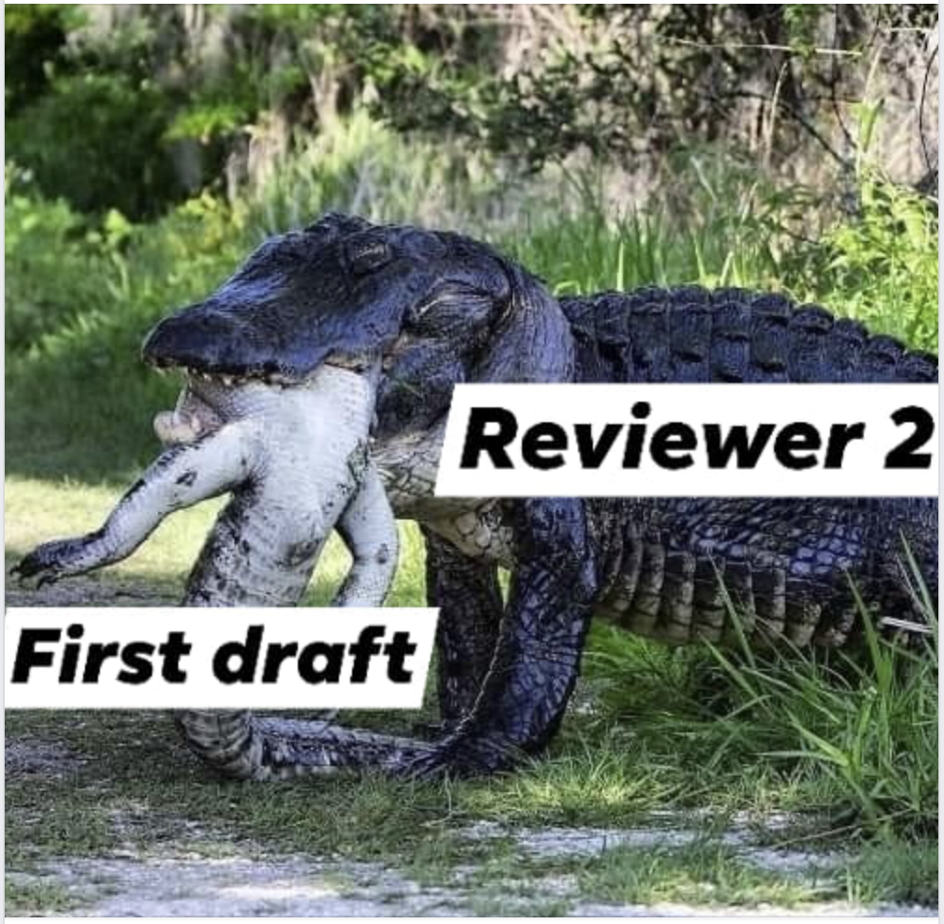
‘Research quality’ means different things in different fields and contexts

Slide 7
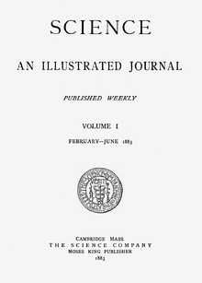
Sites where notions of research quality are formed

Slide 8
1. Types of notions
Field-Type
Space-Type
2. Attributes
Plausibility/reliability
Originality
3. Sites
Individual researchers/groups
(Subject; Anchor; Enforcement; Standards)
Knowledge communities
Research organisations
Research funding agencies
National/regional policy
Value
Langfeldt, Nedeva, Sörlin, Thomas. 2019. Co-existing Notions of Research Quality. Minerva,10.1007/s11024-019-09385-2

Slide 9
Is societal impact part of the notion of good research in your org./fields involved? Why/why not?
Discussion 1

Slide 10
Understand how policy impacts research
Funding and governance: Control research resources; evaluation regimes; national agenda
Research organisations: Control recruitment/careers; local infrastructure/resources
Research practises
Content (topic, questions, methods, theoretical approach)
Organization (e.g. collaboration, user interaction)
Writing and publication practices (length, outlet, language)
Types of effects
Superficial/instrumental adaption (e.g. window dressing)
Changed norms: perceptions of what are valuable topics/activities/collaboration/approaches/methods
Goal displacement
Knowledge communities (research fields, journals, conferences): Control dominant approaches/ theories/methods
Users/stakeholders: May control research resources; important relations/legitimacy

Slide 11
R-QUEST survey on research quality
To researchers in 3 fields in 5 countries
Sample 9060
Replies 2587
Response rate 28.6%

Slide 12
Ability to evaluate the quality of your research: relative rank based on average scores (1=very low ability; 5 = very high ability)
 | Cardiology | Economics | Physics
1 | Myself (3,94) | My scholarly network outside dept (4,21) | Myself (4,10)
2 | Colleagues in my group/unit (3,82) | Myself (4,01) | My scholarly network outside dept (3,95)
3 | My scholarly network outside dept (3,70) | Reviewers of papers (3,83) | Colleagues in my research group/unit (3,91)
4 | Reviewers of papers (3,69) | Colleagues in my research group/unit (3,81) | Reviewers of papers (3,70)
5 | Reviewers ERC (3,39) | The head of my department/unit (3,00) | Reviewers ERC (3,27)
6 | Panels that have evaluated my unit (3,37) | Reviewers ERC (2,95) | The reviewers H2020 (3,12)
7 | Reviewers national funding source (3,36) | Reviewers national funding source (2,93) | Reviewers national funding source (3,10)
8 | The reviewers H2020 (3,23) | Panels that have evaluated my unit (2,90) | Panels that have evaluated my unit (3,06)
9 | The head of my department/unit (3,11) | The reviewers H2020 (2,66) | The head of my department/unit (2,95)
10 | My partners outside academia (2,93) | My partners outside academia (2,44) | My partners outside academia (2,70)
R-QUEST survey 2018

Slide 13
The best in your specific field/speciality. Why do you consider this the best research?
R-QUEST survey 2017-18

Slide 14
‘The best research in your field’ – free text replies, examples
Cardiovascular
‘is based on sound research and facts, rather than on opinions, authorities’
‘Able to address issues fast and get studies done first’
‘Has changed clinical practise’
‘changed way of thinking’
Physics
‘They are changing the way we approach scientific problems, by addressing overarching questions rather than solving special cases’
‘Game changing, thinking outside the box - i.e., really innovative’
‘inspires public to new views of reality’
Economics
‘I found it interesting. The very best research always makes me think: "I would be really proud to have done that“’
‘Was really committed to solving really existing problems rather than hypothetical, model-generated questions, and, moreover, was not glued to established formats like neoclassical formats.’
‘it was hard work and researchers are really bright and gifted’
‘It has changed the way we think about things’
R-QUEST survey 2018

Slide 15
‘Best research’
Key differences ‘best research’
Cardiology (aims at applications; employer and state influence over priorities):
value research that benefits society
Physics (subfields compete over significance within a dominant theoretical framework):
contributions to the theoretical core
methodological breakthroughs
Economics (theoretical work is highly valued and knowledge production is organised around a hierarchy of key journals):
contributions to the theoretical core
methodological breakthroughs
citations and journal impact factors
Characteristics of the best research
Much similarity between the fields
Much variation within the fields
Disciplines are heterogenous
Notions reflect the different organisation and aims of research
At university: theoretical framework
At research institute: benefit society

Slide 16
Implications
The role of research policy
General criteria/indicators that can be used for priorities/allocating resources
Form mutual criteria (and understanding?) across different disciplines and fields
Criteria and procedures that are broad/flexible enough to cover the diversity of quality notions?
Those (subfields/organisations) who have definitory power/shape the criteria,
define winners and losers in the competition for public funding
Need a nuanced understanding of research quality

Slide 17
Who defines what is important and valuable research in your organisation/involved fields? Does a common strategy across fields make sense?
Discussion 2

Slide 18
Thank you for the attention!
R-QUEST Policy Brief no. 1.
Identifying and facilitating high quality research.
liv.langfeldt@nifu.no
www.r-quest.no

